Slide 1
CREID Social Network Analysis
Eric J. Earley, PhD
Greg Sempowski, PhD
April 2024

Slide 2
Social Network Analysis
Sources of data:
Primary connections (RC RS):
Institutional mapping briefs
Site capacities
Secondary connections (RS Field site/gov’t/etc):
2020 Survey – Outbreak Research Response

Slide 3
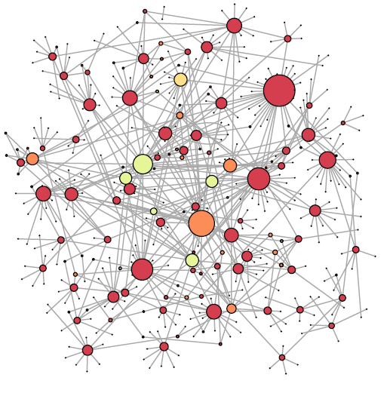
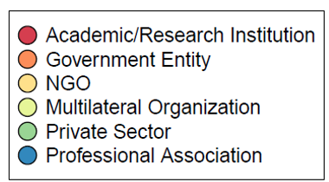
Centre Pasteur du Cameroun
CREID-ECA
CREID-ESP
Mountain Gorilla Vet Project
CREID-CC
WARN-ID
PICREID
Nat’l Public Health Inst.
UWARN
Institute Pasteur de Dakar
WAC-EID
U.S. CDC
CREATE-NEO
U.C. Berkeley
EpiCenter
A2CARES

Slide 4
Entity type | Number
Unique entities | 436
Academic entities | 258
Government entities | 141
Multilateral organization entities | 14
Professional Association entities | 19
NGO entities | 2
Private sector entities | 2
Connection type | Number
Primary connections (within network) | 160
Secondary connections (extended network) | 449
Total connections | 609

Slide 5
OLDER SLIDES
BEFORE MAY 30, 2024

Slide 6
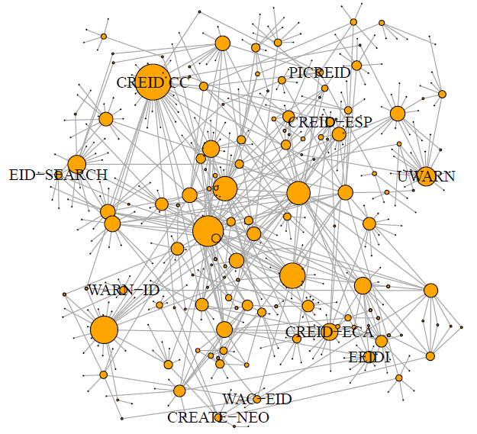
Entity | Degree
CREID CC | 34
UWARN | 18
CREID-ECA | 16
A2CARES | 16
EpiCenter | 11
CREID-ESP | 8
CREATE-NEO | 7
PICREID | 7
WARN-ID | 7
EID-SEARCH | 7
WAC-EID | 7

Slide 7
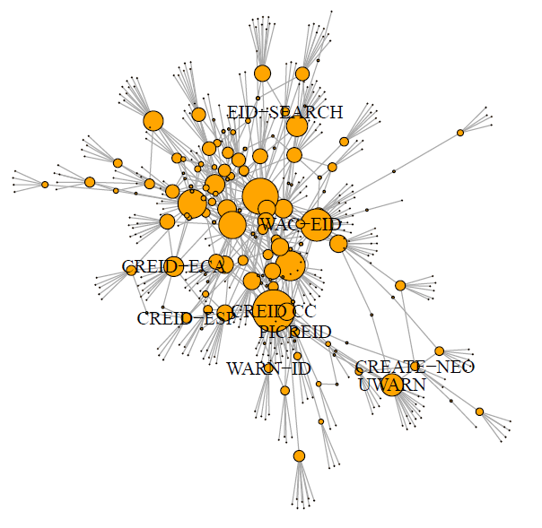
Total Entities | 456

Slide 8
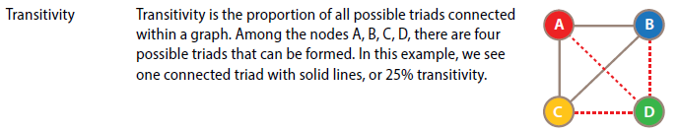
Total Entities | 456
Global transitivity | 0.015 (low)

Slide 9
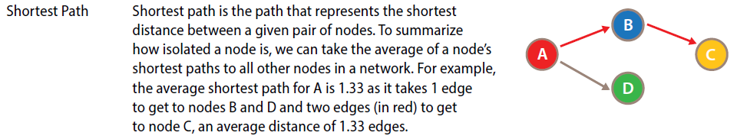
Total Entities | 456
Global transitivity | 0.015 (low)
Mean distance | 4.5

Slide 10
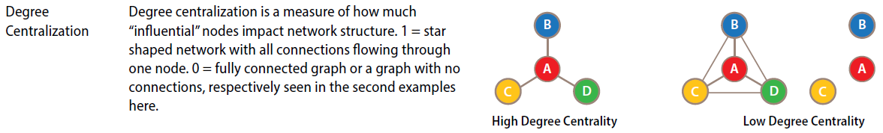
Total Entities | 456
Global transitivity | 0.015 (low)
Mean distance | 4.5
Degree centralization (0...1) | 0.07 (low)

Slide 11
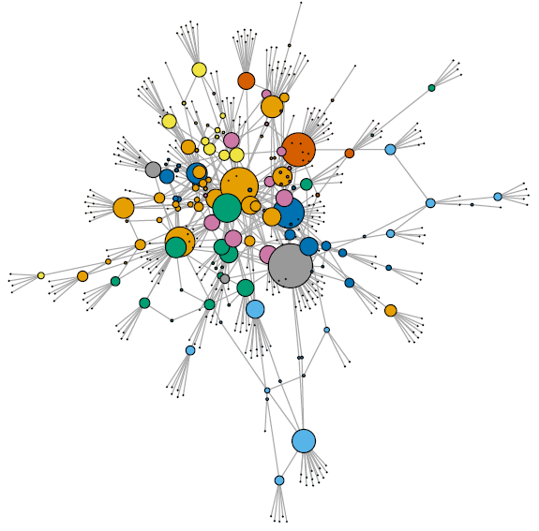
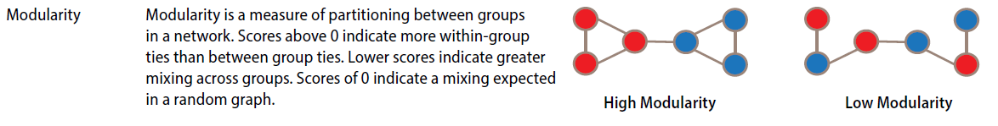
Measures of modularity
No. of “communities” | 20
Modularity (-1..1) | 0.71

Slide 12
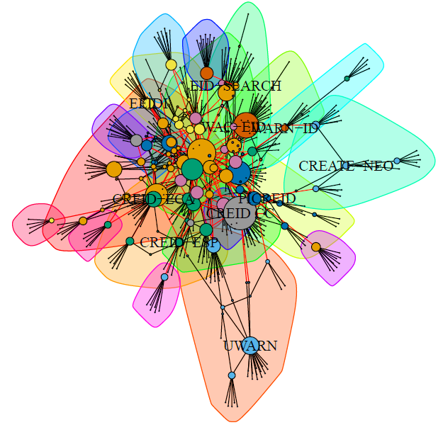
Measures of modularity
No. of “communities” | 20
Modularity (-1..1) | 0.71

Slide 13
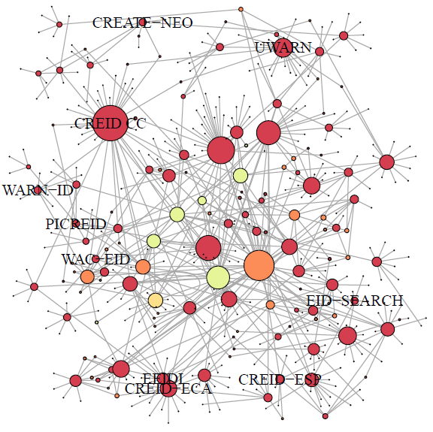


Slide 14
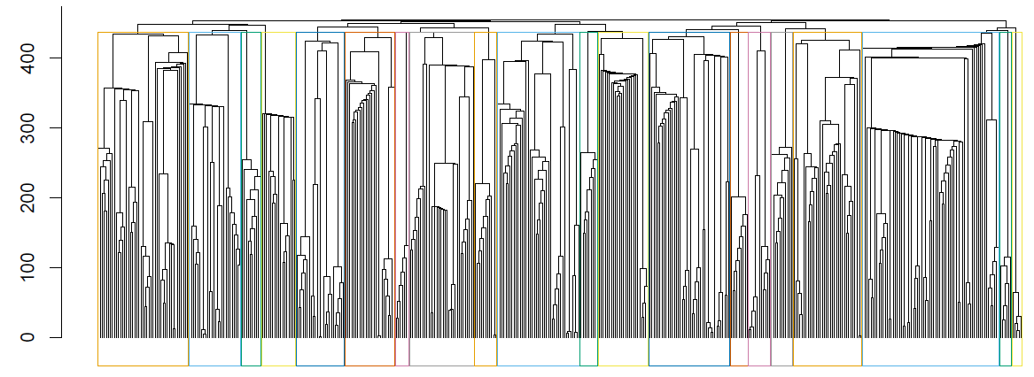
Measures of modularity
No. of “communities” | 20

Slide 15
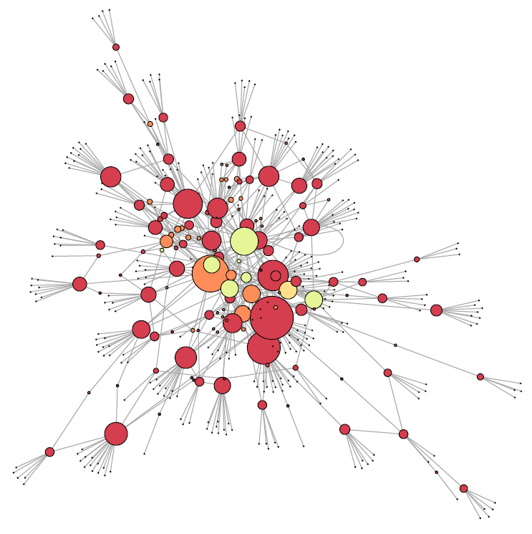

Slide 16
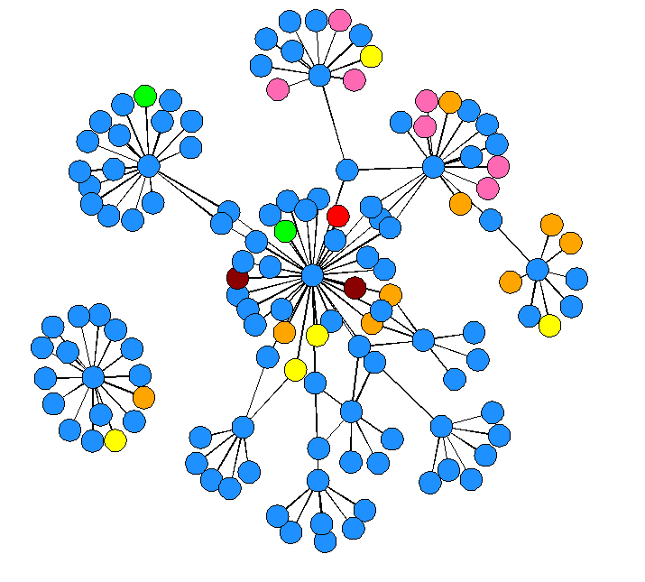
EpiCenter
UWARN
CREID-ECA
CREID-ESP
CREID CC
PICREID
Academic/Research Institute
WAC-EID
Local Government
NGO
A2CARES
Private Sector
CREATE-NEO
CREID Field Site
WARN-ID
Professional Association
EID-SEARCH
US & Foreign Gov’t

Slide 17
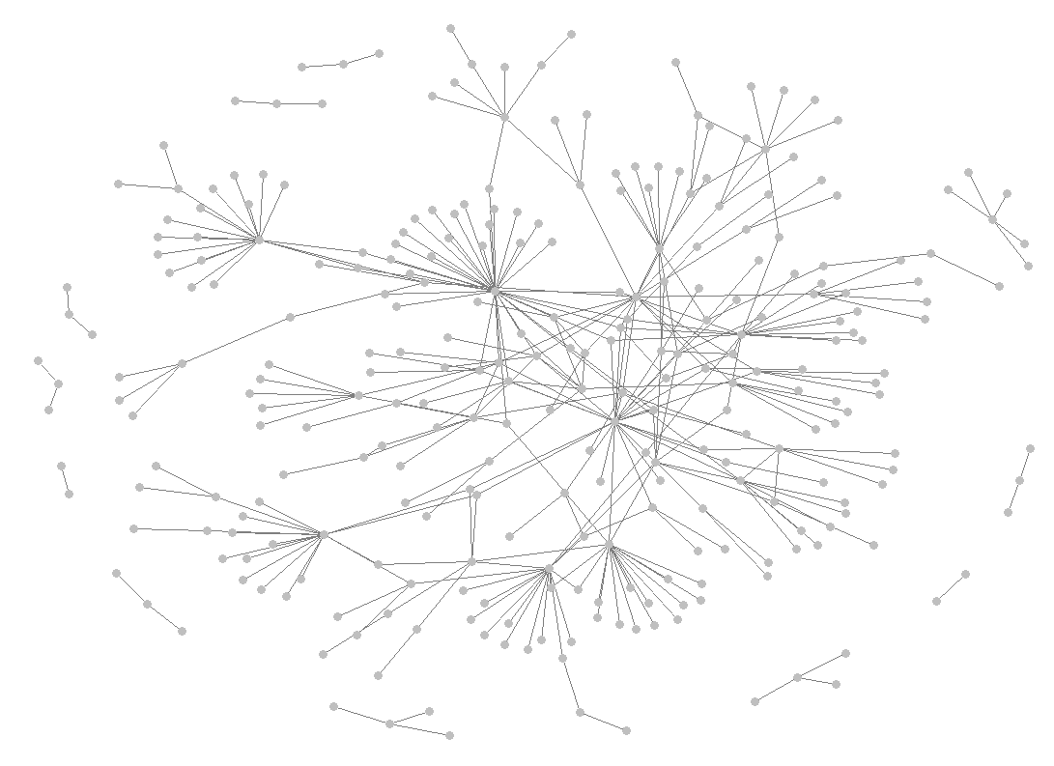
CREID CC
Research Center

Slide 18
